Slide 1


Lecture 22
Produced by Dr. Worldwide
Welcome to the 305
~
~

Slide 2

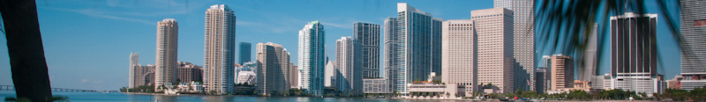
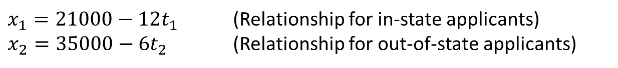
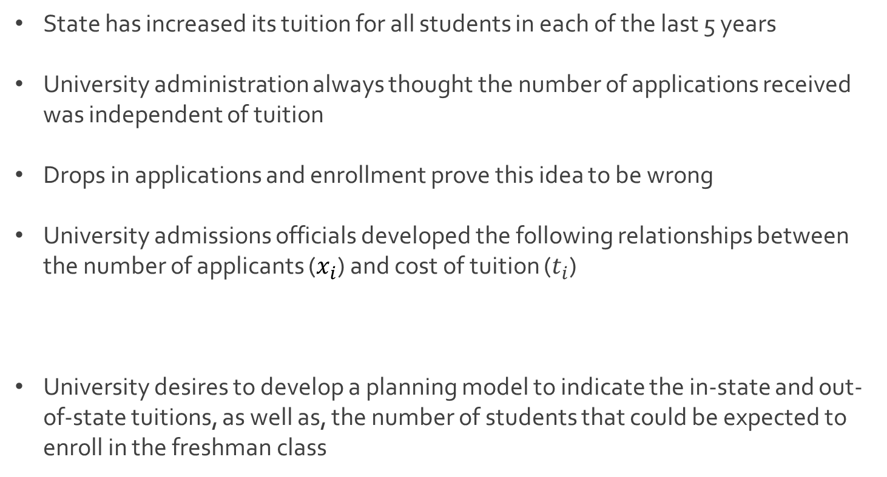
Ex: Admissions at State
State has increased its tuition for all students in each of the last 5 years
University administration always thought the number of applications received was independent of tuition
Drops in applications and enrollment prove this idea to be wrong
University admissions officials developed the following relationships between the number of applicants ($x_{i}$) and cost of tuition ($t_{i}$)
University desires to develop a planning model to indicate the in-state and out-of-state tuitions, as well as, the number of students that could be expected to enroll in the freshman class
$x_{1}=21000−12t_{1}$ (Relationship for in-state applicants)
$x_{2}=35000−6t_{2}$ (Relationship for out-of-state applicants)

Slide 3
Ex: Admissions at State
Constraints based on resources
Not enough classroom space for more than 1,400 students
Needs at least 700 freshmen to meet all its class size objectives
At most 800 dorm rooms available for freshmen
Historical expectations
55% of all in-state freshmen desire to live in dorms
72% of all out-of-state freshmen desire to live in dorms
Uphold the academic standards of the institution
Average SAT is 960 for in-state students
Average SAT is 1150 for out-of-state students
University wants the entering freshmen to average 1,000

Slide 4
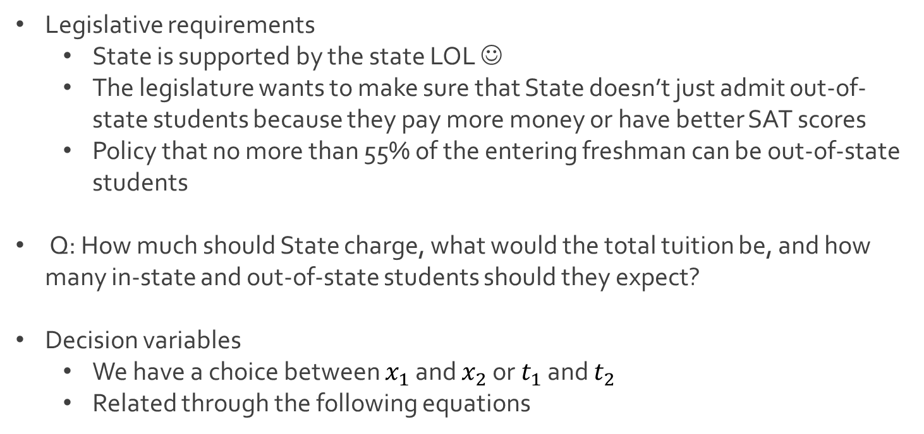
Ex: Admissions at State
Legislative requirements
State is supported by the state LOL ☺
The legislature wants to make sure that State doesn’t just admit out-of-state students because they pay more money or have better SAT scores
Policy that no more than 55% of the entering freshman can be out-of-state students
Q: How much should State charge, what would the total tuition be, and how many in-state and out-of-state students should they expect?
Decision variables
We have a choice between $x_{1}$ and $x_{2}$ or $t_{1}$ and $t_{2}$
Related through the following equations
$x_{1}=21000−12t_{1}$
$x_{2}=35000−6t_{2}$

Slide 5
Ex: Admissions at State
Objective function
Goal is to maximize the revenue in tuition
Total tuition based off in-state and out-of-state students
Constraints
Maximum number of freshmen
Minimum number of freshmen
Maximum number of dormitories
$x_{1}t_{1}+x_{2}t_{2}=x_{1}×\frac{\left(21000−x_{1}\right)}{12}+x_{2}×\frac{(35000−x_{2})}{6}$
$x_{1}+x_{2}≤1400$
$x_{1}+x_{2}≥700$
$0.55x_{1}+{0.72x}_{2}≤800$

Slide 6

Ex: Admissions at State
Constraints
Average SAT Scores
Maximum for out-of-state students
$$\frac{960x_{1}+1150x_{2}}{x_{1}+x_{2}}≥1000$$
$$\left(960−1000\right)x_{1}+\left(1150−1000\right)x_{2}=−40x_{1}+150x_{2}≥0$$
$$\frac{x_{2}}{x_{1}+x_{2}}≤0.55$$
$$−0.55x_{1}+\left(1−0.55\right)x_{2}=−0.55x_{1}+0.45x_{2}≤0$$

Slide 7

Ex: Admissions at State
Nonlinear program
Download Admissions.xlsx from link Sheet 1 on course website
Maximize $x_{1}×\frac{\left(21000−x_{1}\right)}{12}+x_{2}×\frac{(35000−x_{2})}{6}$
Subject to $x_{1}+x_{2}≤1400$
${−x}_{1}−x_{2}≤−700$
${0.55x}_{1}+{0.72x}_{2}≤800$
${40x}_{1}−{150x}_{2}≤0$
${−0.55x}_{1}+{0.45x}_{2}≤0$
$x_{1}, x_{2}≥0$

Slide 8
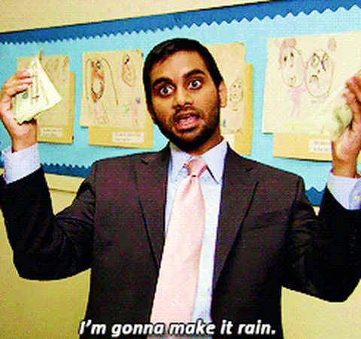
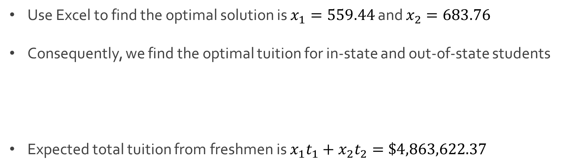
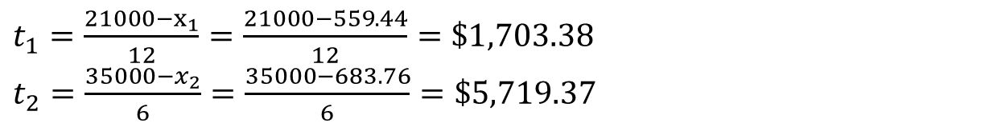
Ex: Admissions at State
Use Excel to find the optimal solution is $x_{1}=559.44$ and $x_{2}=683.76$
Consequently, we find the optimal tuition for in-state and out-of-state students
Expected total tuition from freshmen is $x_{1}t_{1}+x_{2}t_{2}=\$4,863,622.37$
$t_{1}=\frac{21000−x_{1}}{12}=\frac{21000−559.44}{12}=\$1,703.38$
$t_{2}=\frac{35000−x_{2}}{6}=\frac{35000−683.76}{6}=\$5,719.37$

Slide 9
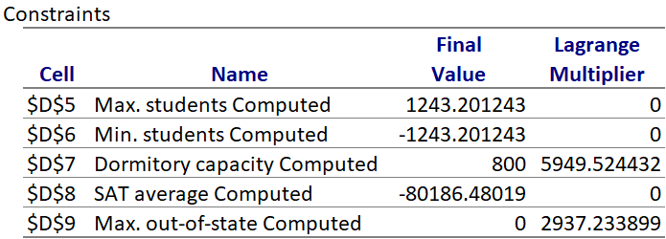

Ex: Admissions at State
Solve again in Excel and save sensitivity report
Q: What does it mean that when the Lagrange multiplier is $0$?

Slide 10




The End
Dale

